Slide 1
COS GROUP PROJECT

Slide 2
GROUP MEMBERS
ISHAKU ANDREW BHU/23/04/09/0050
NEMUEL NUHYEL LAUSHI BHU/23/04/09/0046
EBENCHI SIMEON BHU/23/04/05/0027
NDUKWE EMMANUEL KALU BHU/23/04/09/0076

Slide 3
WHAT IS CALCULATOR PROGRAM ?
A calculator program is a software applications used for carrying out basic arithmetic/mathematical operations. Measurement and calculation has gradually become an essential part of human behaviour. In this particular program, we will only explore the basic arithmetic functions; addition, subtraction, multiplication and division.

Slide 4
MODULES USED:
Tkinter
This is graphical user interface (GUI) programmed directly into python, it provides all the functionality for creating a graphical user interface.

Slide 5
INTEGRATED DEVELOPMENT ENVIRONMENT AND TKINTER LAYOUT USED:
IDE USED:
Visual Studio Code (VScode)
TKINTER LAYOUT USED:
Grid ( )
Pack ( )

Slide 6
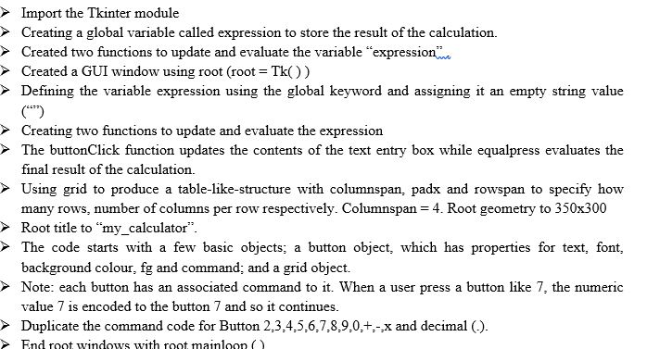
PSEUDOCODE

Slide 7
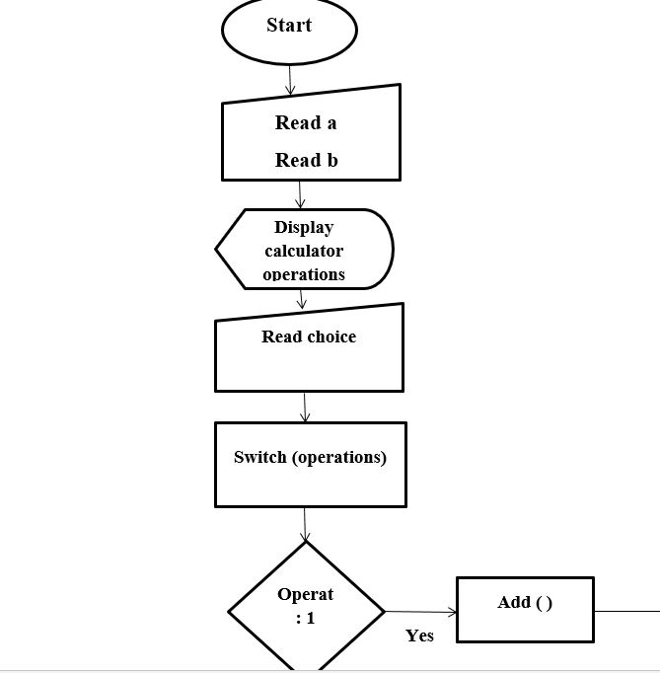
FLOWCHART

Slide 8
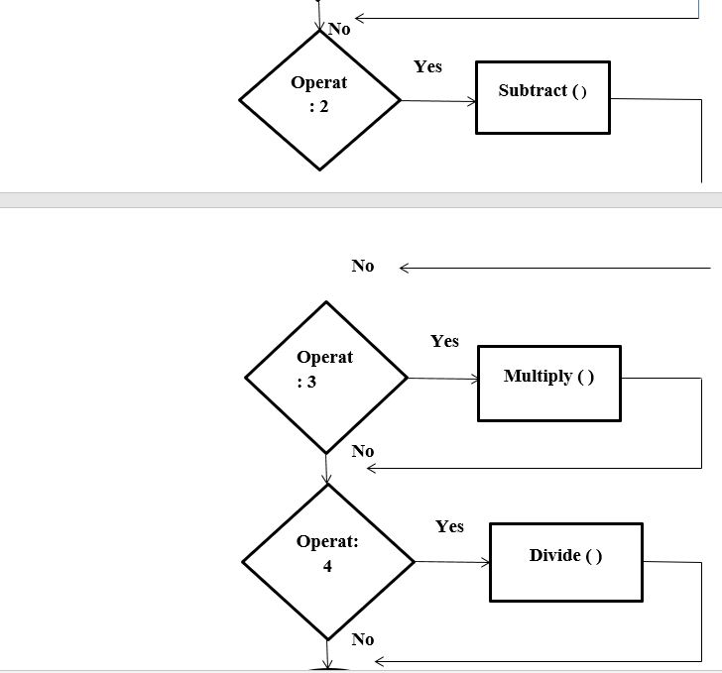
FLOWCHART CONTINUED

Slide 9
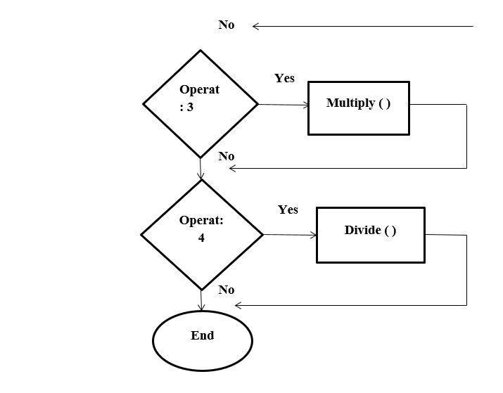
FLOWCHART CONTINUED

Slide 10
THANK YOU!!!

